Slide 1





COSMO-PLAN
SPACE -EXPLORATION MANAGEMENT SYSTEM
Dhwanil Panchani
Shalini Dutta
Zeel Patel
Atharv Konge
Kiran Reddy

Slide 2






Misson Statement
Develop integrated database system for streamlined space exploration missions
.
Objectives:
Optimize planning processes and resource allocation
Data Centralization and Accessibility
Enhance communication channels
Implement advanced risk management strategies
Effective Mission Planning
Approach:
Build robust centralized database
Leverage SQL to add valuable functionalities
Facilitate analytical visualizations
Database Design:
Identify required entities
Establish relationships
Define essential attributes

Slide 3
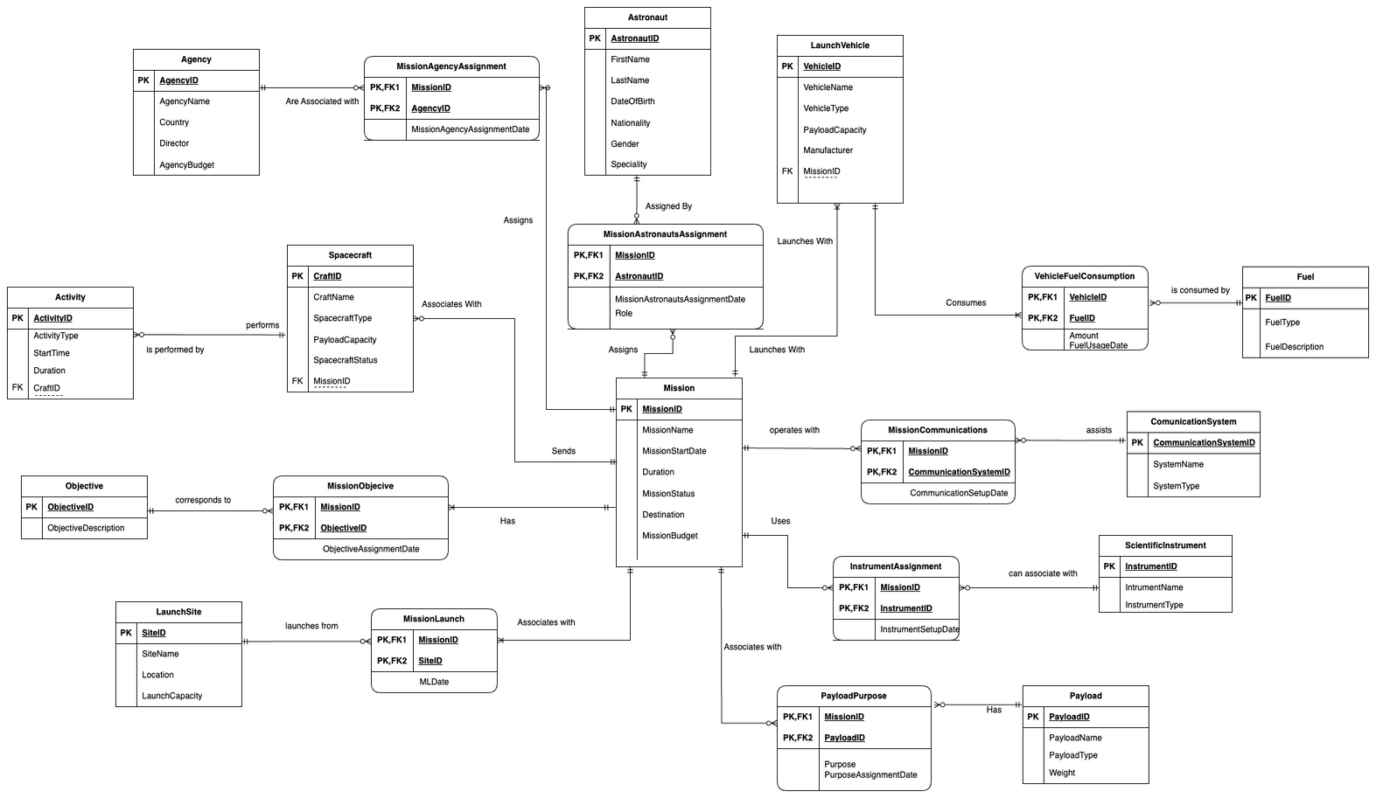
ERD

Slide 4



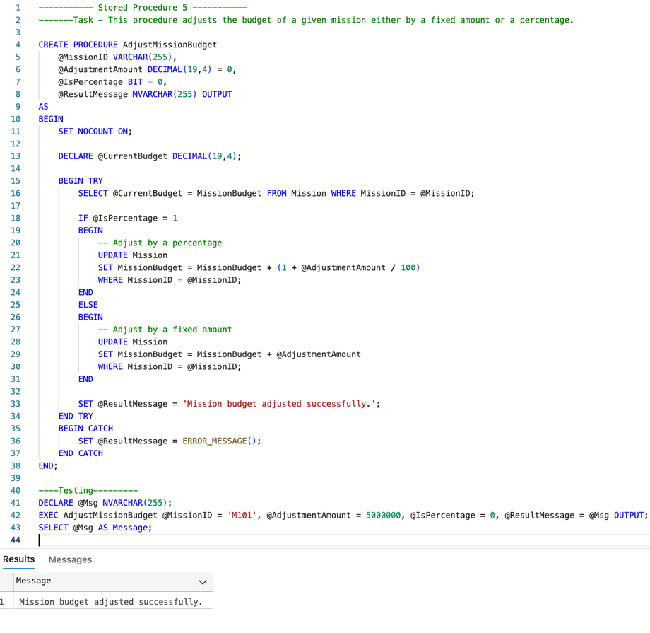
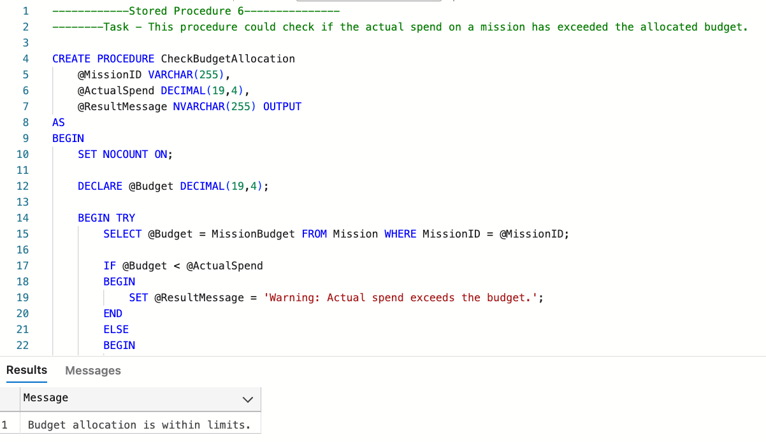

Stored procedures (6)

Slide 5
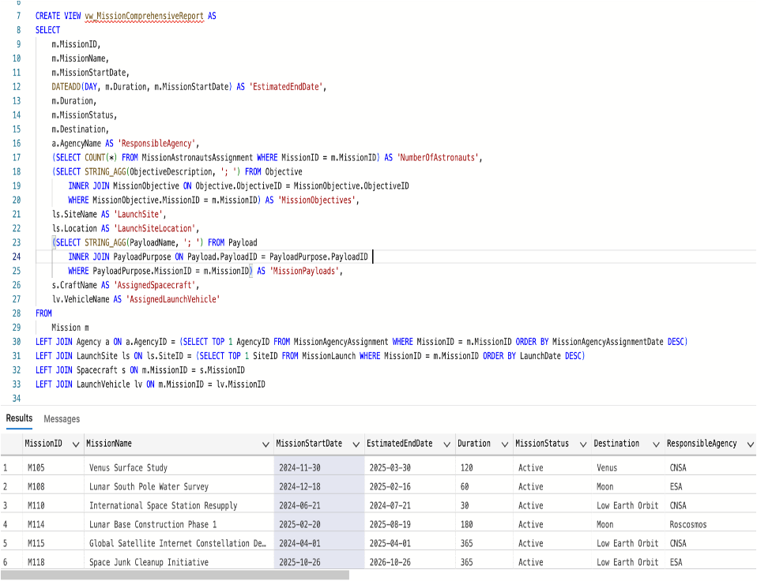
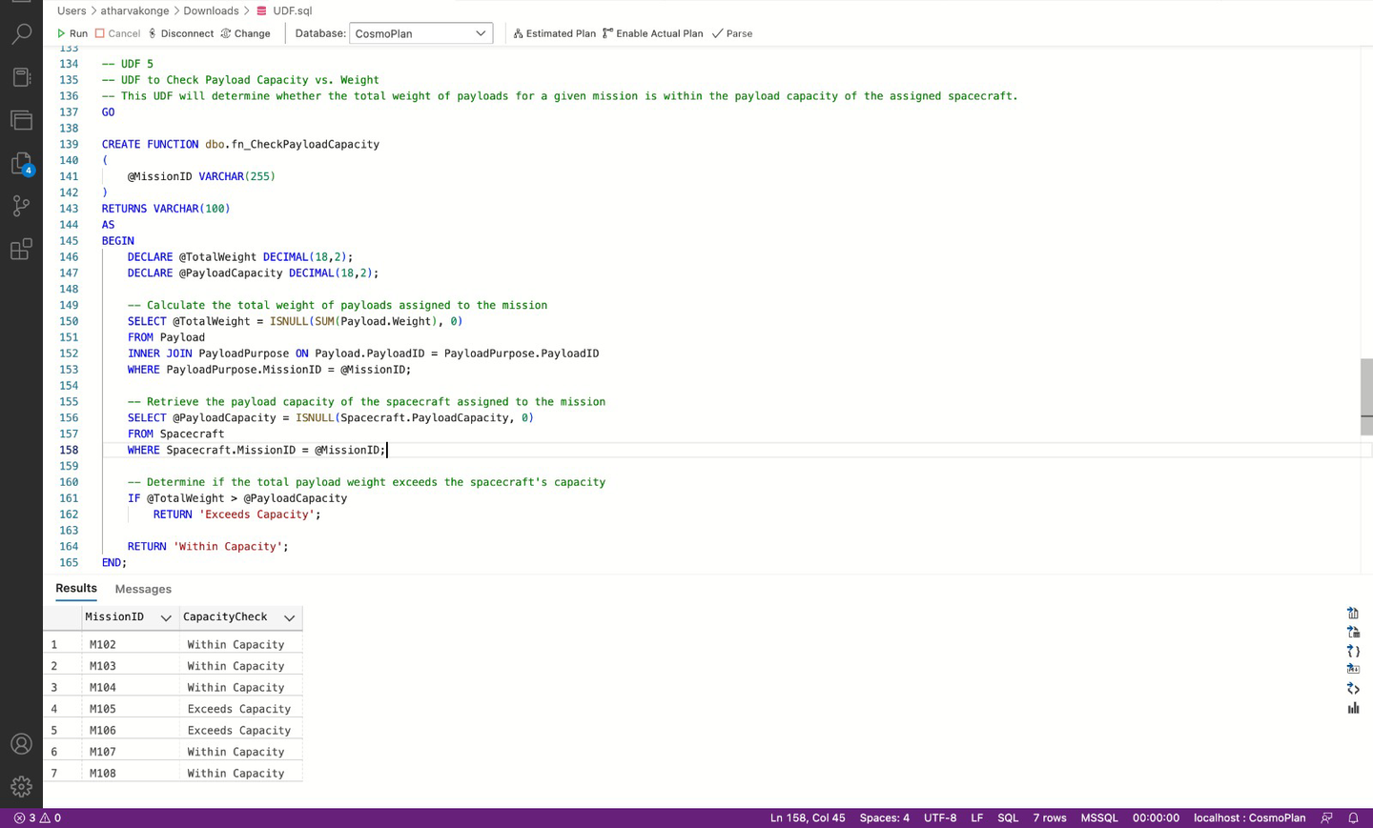
Views(3)
User Defined Functions(5)

Slide 6
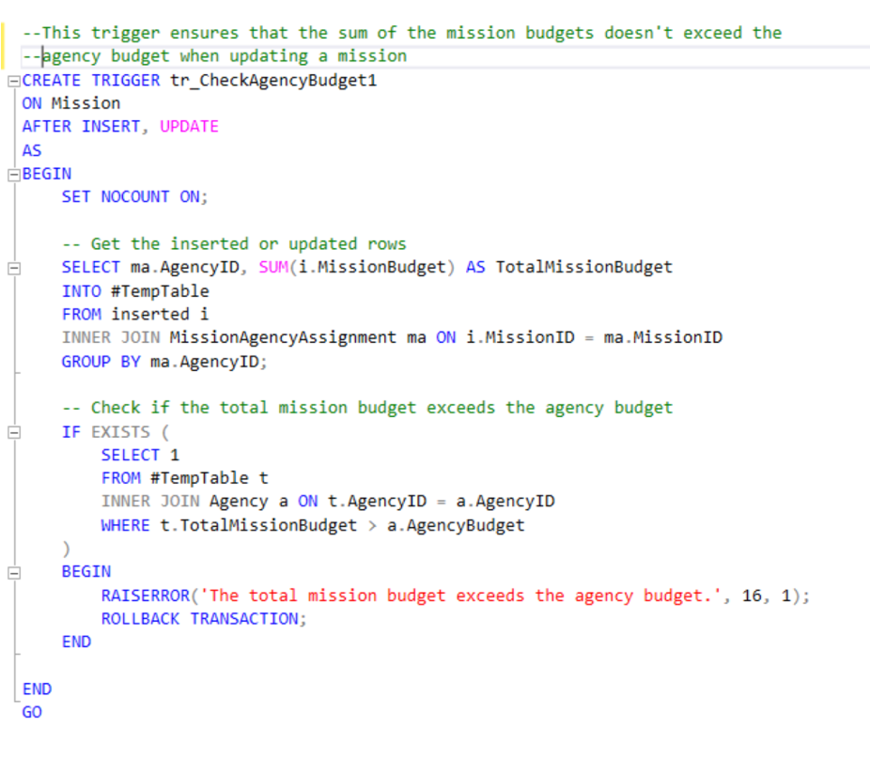
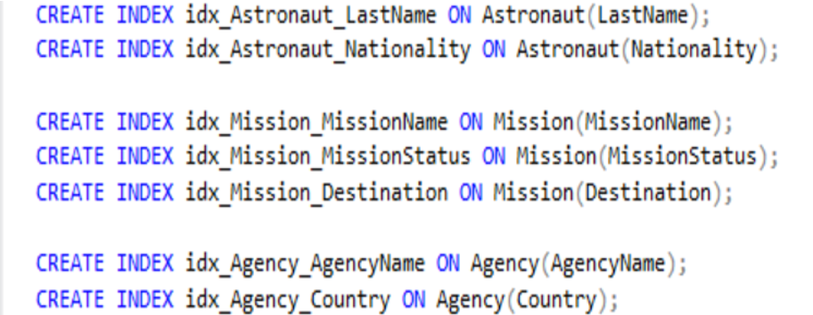
Triggers(4)
Non-clustered Indexes(7)

Slide 7
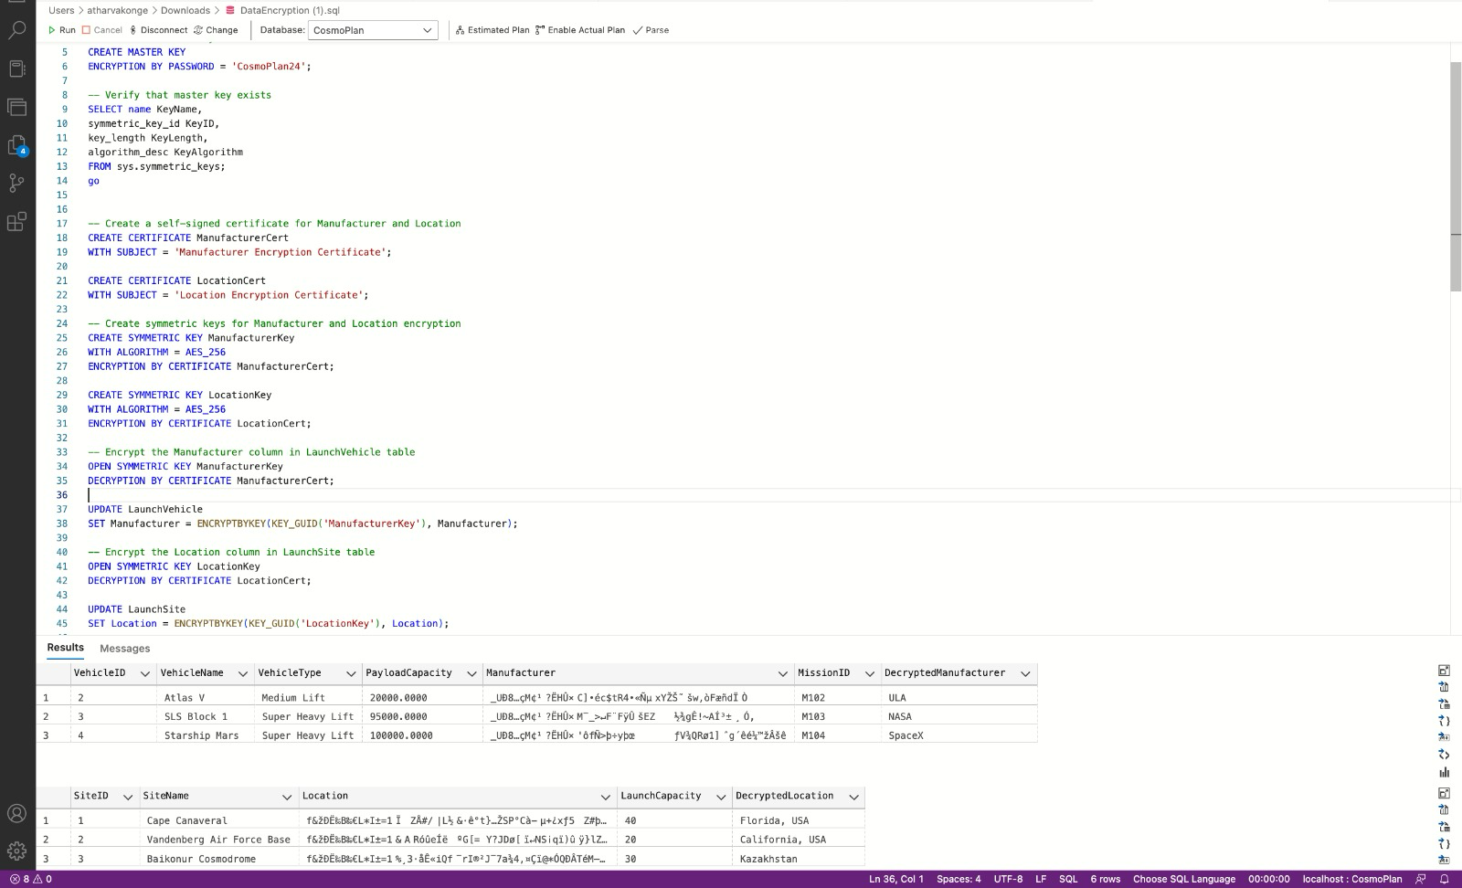
Data Encryption(2)

Slide 8

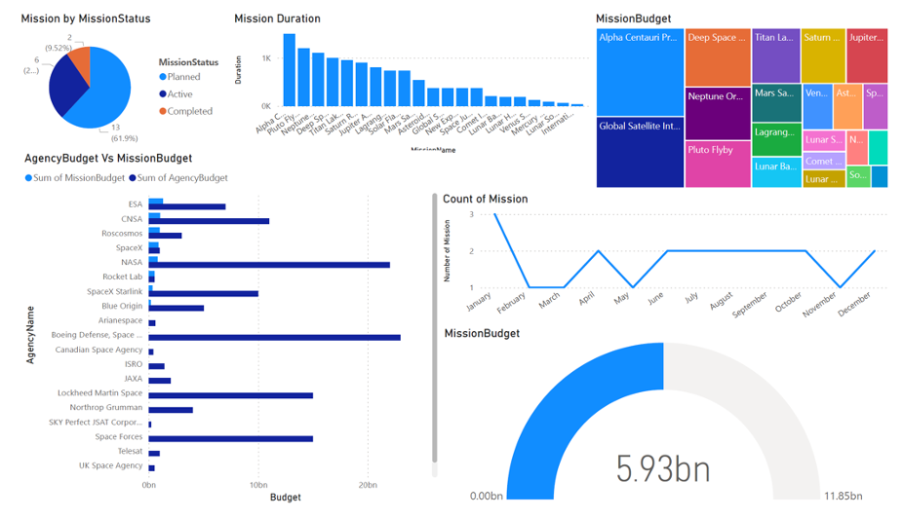


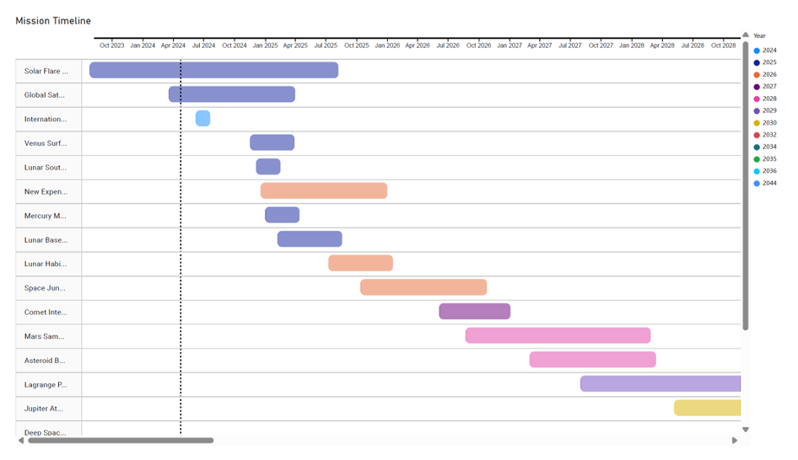


PowerBi Dashboard

Slide 9

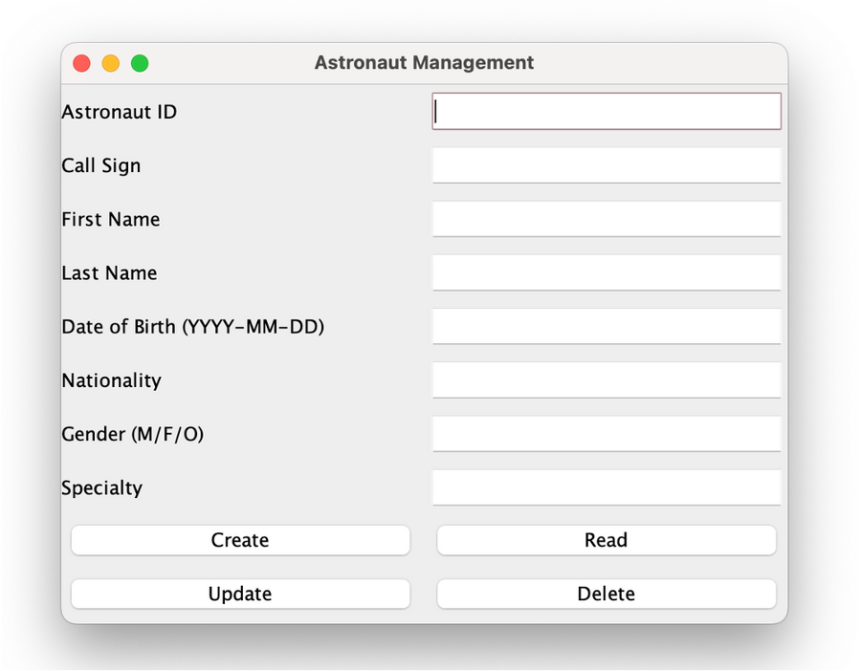
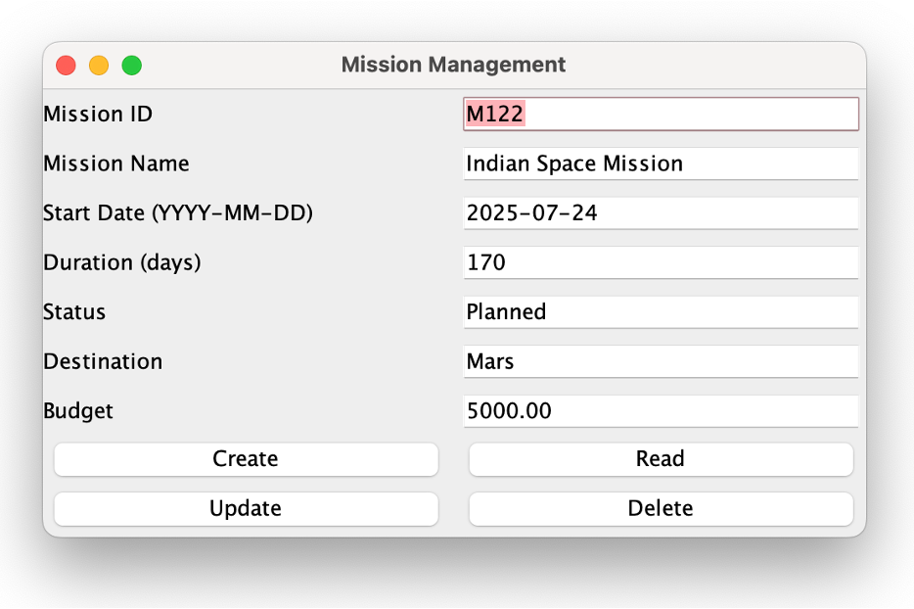
GUI & Demo

Slide 10



Thank You
Any Questions?

